Slide 1




What is wi-fi
Wi-Fi
Radio waves
High-speed
network and
Internet connections

Slide 2


Open.
Non-profit.
Responsible of Wi-Fi standards development, marketing, Wi-Fi certification,…

Slide 3



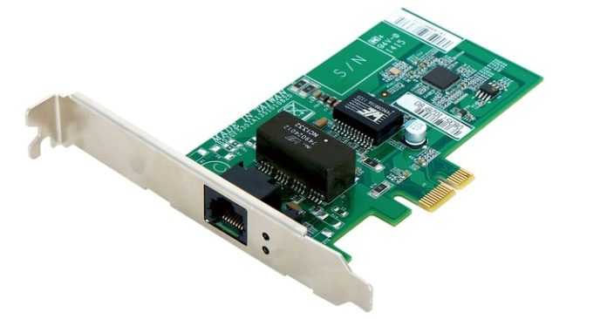


How does wi-fi work
DATA
DATA

Slide 4
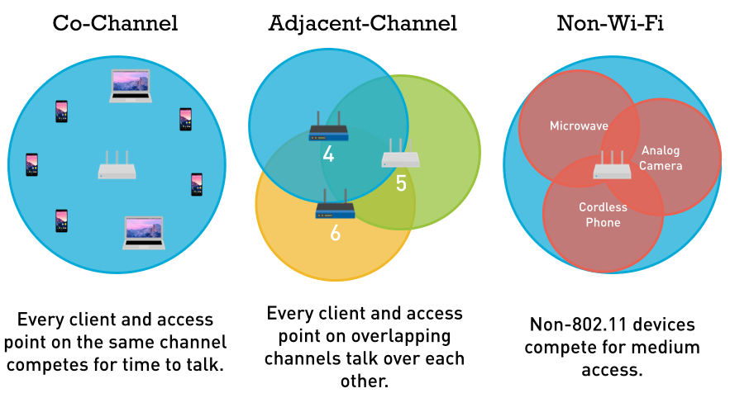
Wi-fi channel
2 GHz
or
5Ghz

Slide 5
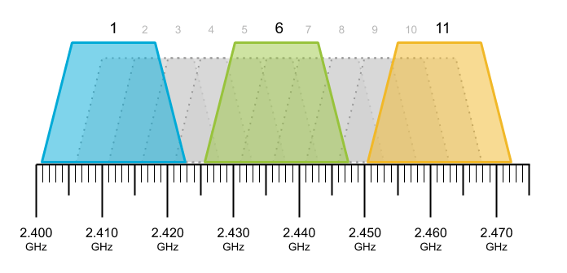
Wifi channel

Slide 6
Future of wi-fi

Slide 7
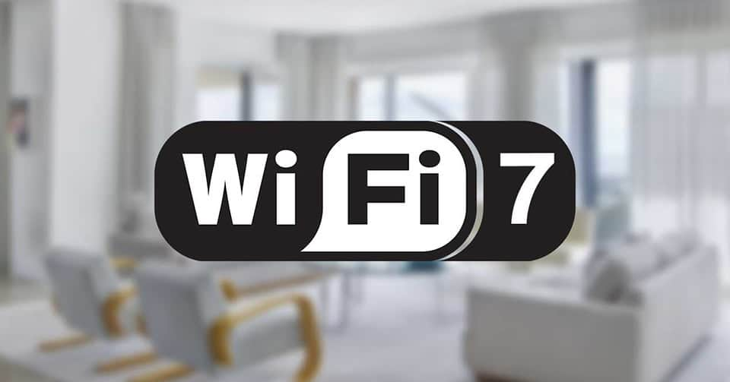
Wi-fi 7(802.11be)
6 GHz band ➔ Offering high-speed Wi-Fi.
Support multi-band and multi-channel.
Handle a numerous of devices simultaneously.

